Slide 1


Roman Naidenko
November 25th, 2022

Slide 2

Outline
Executive Summary
Introduction
Methodology
Results
Conclusion
Appendix

Slide 3
Executive Summary
Summary of methodologies:
Data collection (API, WEB scrapping);
Exploratory Data Analysis;
Modeling and visualization;
Prediction and decision making.
Summary of all results:
Results of EDA;
Interactive analytics;
Predictive analysis results.

Slide 4
Introduction
Project background and context:
Because of successful reusability of the 1st stage the Falcon 9 Rocket launch costs 62 million dollars against 165 million dollars from other providers;
Determining success of the 1st stage landing we can predict such expenditures and build a model;
Problems you want to find answers:
What are the reasons of landing success or failure?
How to achieve a better success landing rate?

Slide 5

Section 1

Slide 6
Methodology
Executive Summary
Data collection methodology:
REST API (SpaceX site);
WEB scrapping (Wikipedia).
Perform data wrangling
One-Hot Encoding
Perform exploratory data analysis (EDA) using visualization and SQL
Perform interactive visual analytics using Folium and Plotly Dash
Perform predictive analysis using classification models
How to build, tune, evaluate classification models such as LR, KNN, SVM etc.

Slide 7
Data Collection
Data collection process:
REST API request (https://api.spacexdata.com/v4/rockets/);
JSON response;
WEB scrap HTML request (https://en.wikipedia.org/wiki/List_of_Falcon\_9\_and_Falcon_Heavy_launches);
Data wrangling and export to .csv.
Data collection flowcharts:
REST API request
.JSON response
Dataframe to .csv
Ready data
WEB scrap HTML request
Beautiful soup object
Dataframe to .csv

Slide 8

Data Collection – SpaceX API
REST API response:
Converting to .JSON:
Data transformation:
Dataframe
Export data:
You can find more about Data Collection here:
Data collection (SpaceX API)

Slide 9
Data Collection - Scraping
HTML response:
Beautiful soup object:
Create a dictionary:
Dataframe from dictionary and export data:
You can find more about Data Collection here:
Data collection (Scraping)

Slide 10
Data Wrangling
There are several different cases where the booster did not land, such as:
False Ocean, False RTLS, False ASDS means the mission was a failure.
We will mainly convert those outcomes into Training Labels with 1 means the booster successfully landed 0 means it was unsuccessful.
Calculate launches number for each site
Determine the number and occurrence of each orbit
Find number and occurrence of mission outcome per orbit type
Export data
Data wrangling

Slide 11
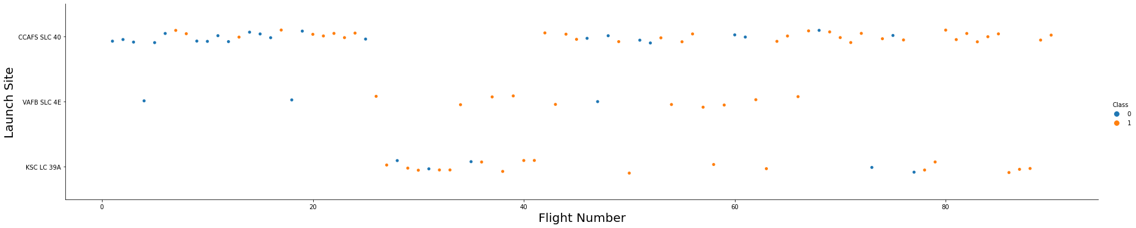
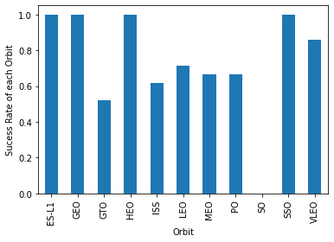
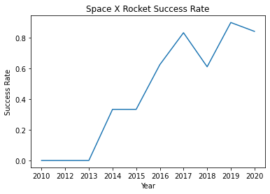
EDA with Data Visualization
Scatter plots show relationship between variables.
Bar graphs show the relationship between numeric and categoric variables.
Line graphs show data variables and their trends. And can help to show global behavior and make prediction for unseen data.
EDA with Data Visualization

Slide 12
EDA with SQL
We performed SQL queries to gather and understand data from dataset:
Displaying the names of the unique launch sites in the space mission.
Display 5 records where launch sites begin with the string 'CCA'
Display the total payload mass carried by boosters launched by NASA (CRS).
Display average payload mass carried by booster version F9 v1.1.
List the date when the first successful landing outcome in ground pad was achieved.
List the names of the boosters which have success in drone ship and have payload mass greater than 4000 but less than 6000.
List the total number of successful and failure mission outcomes.
List the names of the booster_versions which have carried the maximum payload mass.
List the records which will display the month names, failure landing_outcomes in drone ship, booster versions, launch_site forthe months in year 2015.
Rank the count of successful landing_outcomes between the date04-06-2010 and 20-03-2017in descending order.
EDA with SQL

Slide 13
Build an Interactive Map with Folium
Folium map object is a map centered on NASA Johnson Space Center at Houston, Texas:
Red circle at NASA Johnson Space Center's coordinate with label showing its name(folium.Circle, folium.map.Marker).
Red circles at each launch site coordinates with label showing launch site name (folium.Circle, folium.map.Marker, folium.features.DivIcon).
The grouping of points in a cluster to display multiple and different information for the same coordinates (folium.plugins.MarkerCluster).
Markers to show successful and unsuccessful landings. Greenf or successful landing and Red for unsuccessful landing. (folium.map.Marker, folium.Icon).
Markers to show distance between launch site to key locations (railway, highway, coastway, city) and plot a line between them. (folium.map.Marker, folium.PolyLine, folium.features.DivIcon)
These objects are created in order to understand better the problem and the data. We can show easily all launch sites, their surroundings and the number of successful and unsuccessful landings.
Interactive Map with Folium

Slide 14
Build a Dashboard with Plotly Dash
Dashboard has dropdown, pie chart, rangeslider and scatter plot components
Dropdown allows a user to choose the launch site or all launch sites (dash_core_components.Dropdown).
Pie chart shows the total success and the total failure for the launch site chosen with the dropdown component (plotly.express.pie).
Rangeslider allows a user to select a payload mass in a fixed range (dash_core_components.RangeSlider).
Scatter chart showsthe relationship between two variables, in particular Success vs Payload Mass (plotly.express.scatter).
Dashboard

Slide 15
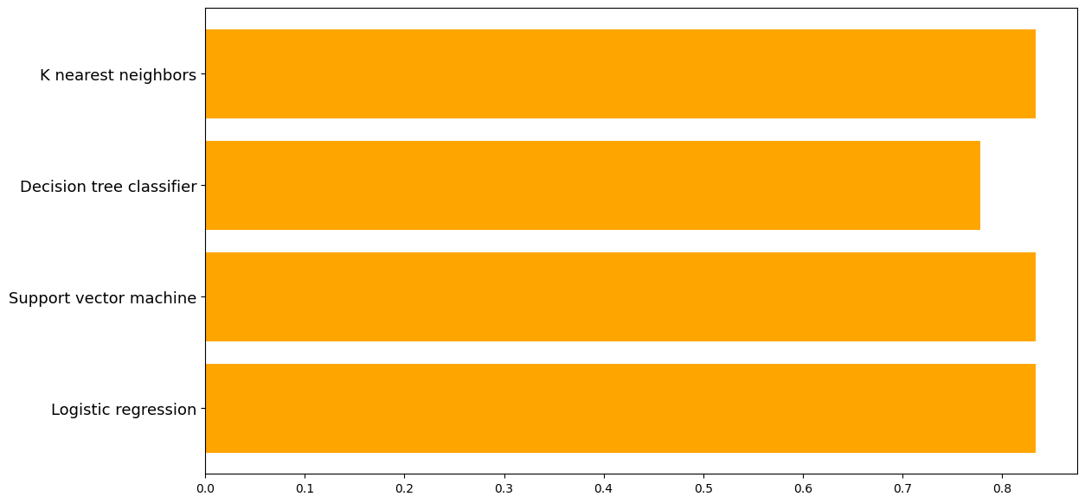
Predictive Analysis (Classification)
Data preparation
Load dataset
Normalize data
Split data into training and test sets.
Model preparation
Selection of machine learning algorithms
Set parameters for each algorithm to GridSearchCV
Training GridSearchModel models with training dataset
Model evaluation
Get best hyperparameters for each type of model
Compute accuracy for each model with test dataset
Plot Confusion Matrix
Model comparison
Comparison of models according to their accuracy
The model with the best accuracy will be chosen
Prediction analysis

Slide 16

Results
Orbits GEO, HEO, SSO, ES L1 have the highest success rate.
Low-weighted payload performs better than the heavier one.
SVM, KNN and Logistic Regression models have most prediction accuracy.

Slide 17

Section 2

Slide 18
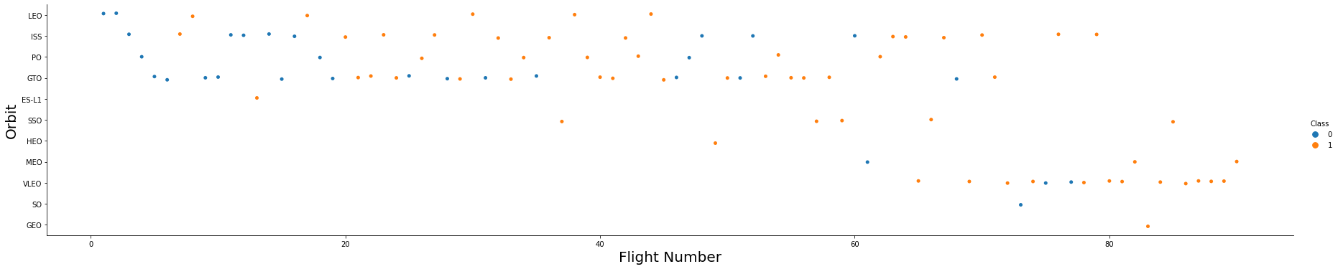
Flight Number vs. Launch Site
For each site, success rate increases.

Slide 19
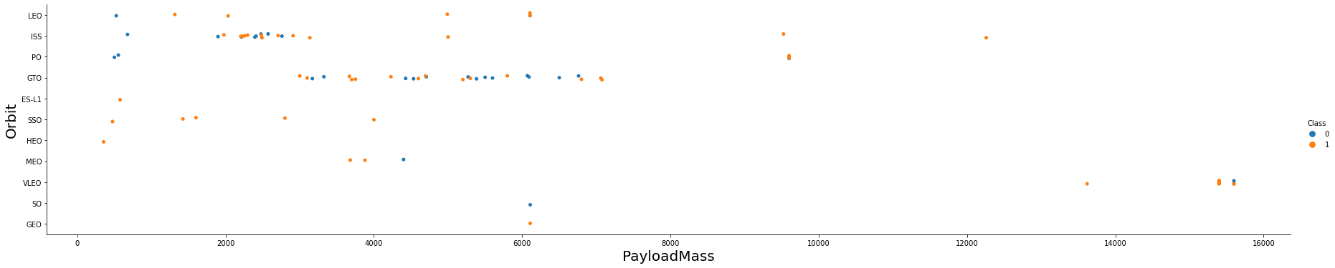
Payload vs. Launch Site
Depending on the launch site, a heavier payload is considered as a successful landing. On the other hand, a too heavy payload causes a landing fail.

Slide 20
Success Rate vs. Orbit Type
We can see success rate for different orbit types. We note that ES L1, GEO, HEO, SSO have the best success rate.

Slide 21
Flight Number vs. Orbit Type
We notice that the success rate increases with the number of flights for the LEO orbit. For some orbits like GTO, there is no relation between the success rate and the number of flights. But we can suppose that the high success rate of some orbits like SSO or HEO is due to the knowledge learned during former launches for other orbits.

Slide 22
Payload vs. Orbit Type
The weight of the payloads can have a great influence on the success rate of the launches in certain orbits. For example, heavier payloads improve the success rate for the LEO orbit. Another finding is that decreasing the payload weight for a GTO orbit improves the success of a launch.

Slide 23
Launch Success Yearly Trend
Since 2013, we can see an increase in the Space X Rocket success rate.

Slide 24
All Launch Site Names
SQL Query:
Explanation:
The use of DISTINCT in the query allows to remove duplicate LAUNCH_SITE.
Result:

Slide 25
Launch Site Names Begin with 'CCA'
SQL Query:
Explanation:
The WHERE clause followed by LIKE clause filters launch sites that contain the substring CCA. LIMIT 5 shows 5 records from filtering.
Result:

Slide 26
Total Payload Mass
SQL Query:
Explanation:
This query returns the sum of all payload masses where the customer is NASA (CRS).
Result:

Slide 27
Average Payload Mass by F9 v1.1
SQL Query:
Explanation:
This query returns the average of all payload masses where the booster version contains the substring F9 v1.1.
Result:

Slide 28
First Successful Ground Landing Date
SQL Query:
Explanation:
With this query, we select the oldest successful landing. The WHERE clause filters dataset in order to keep only records where landing was successful. With the MIN function, we select the record with the oldest date.
Result:

Slide 29
Successful Drone Ship Landing with Payload between 4000 and 6000
SQL Query:
Explanation:
This query returns the booster version where landing was successful and payload mass being between 4000 and 6000 kg. The WHERE and AND clauses filter the dataset.
Result:

Slide 30
Total Number of Successful and Failure Mission Outcomes
SQL Query:
Explanation:
With the first SELECT, we show the subqueries that return results. The first subquery counts the successful mission. The second subquery counts the unsuccessful mission. The WHERE clause followed by LIKE clause filters mission outcome . The COUNT function counts records filtered.
Result:

Slide 31
Boosters Carried Maximum Payload
SQL Query:
Explanation:
We used a subquery to filter data by returning only the heaviest payload mass with MAX function. The main query uses subquery results and returns unique booster version (SELECT DISTINCT) with the heaviest payload mass.
Result:

Slide 32
2015 Launch Records
SQL Query:
Explanation:
This query returns month, booster version, launch site where landing was unsuccessful and landing date took place in 2015. Substr function process date in order to take month or year. Substr(DATE, 4, 2) shows month. Substr(DATE,7, 4) shows year.
Result:

Slide 33
Rank Landing Outcomes Between 2010-06-04 and 2017-03-20
SQL Query:
Explanation:
This query returns landing outcomes and their count where mission was successful, and date is between 04/06/2010 and 20/03/2017. The GROUP BY clause groups results by landing outcome and ORDER BY COUNT DESC shows results in decreasing order.
Result:

Slide 34

Section 3

Slide 35
Folium Map – Ground stations
Here we can see that Space X launch sites are located on the coast of the United States

Slide 36
Folium Map – Colour-labeled markers
Green marker represents successful launches. Red marker represents unsuccessful launches. We can note that KSC LC 39A has a higher launch success rate.

Slide 37
Folium Map – Launch site distance to its aproximities
CCAFS SLC 40 is near railways, highways, coastline.
CCAFS SLC 40 doesn’t keep certain distance away from cities.

Slide 38

Section 4

Slide 39
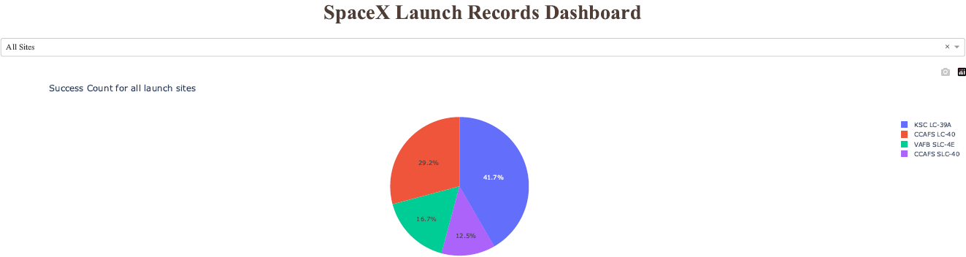
Dashboard – Total success of SpaceX launches by site
KSC LC-39A has the best success rate of launches.

Slide 40
Dashboard – Total success launches (KSC LC-39A)
KSC LC-39A has achieved a 76.9% success rate while getting a 23.1% failure rate.

Slide 41
Dashboard - Payload vs. Launch Outcome
Low-weighted payload has a better success rate than the heavy-weighted one.

Slide 42

Section 5

Slide 43
Classification Accuracy
For accuracy test, all methods performed similar except the decision tree.

Slide 44
Confusion Matrix
The confusion matrices for all models are identical. The main problem of these ones are false positives.

Slide 45
Conclusions
The success of a mission can be explained by several factors such as the launch site, the orbit and especially the number of previous launches. Indeed, we can assume that there has been a gain in knowledge between launches that allowed to go from a launch failure to a success.
The orbits with the best success rates are GEO, HEO, SSO, ES L1.
Depending on the orbits, the payload mass can be a criterion to consider for the success of a mission. Some orbits require a light or heavy payload mass. But generally low weighted payloads perform better than the heavy weighted payloads.
With the current data, we cannot explain why some launch sites are better than others (KSC LC 39A is the best launch site). To get an answer to this problem, we could obtain atmospheric or other relevant data.
For this dataset, we choose the Decision Tree Algorithm as the best model even if the test accuracy between all the models used is identical. We choose Decision Tree Algorithm because it has a better train accuracy.

Slide 46
Appendix
Data collection (SpaceX API);
Data collection (Scraping);
Data wrangling;
EDA with Data Visualization;
EDA with SQL;
Interactive Map with Folium;
Dashboard;
Prediction analysis.

Slide 47


